Slide 1
Design Patterns RESUME
User and Developer Manual

Slide 2
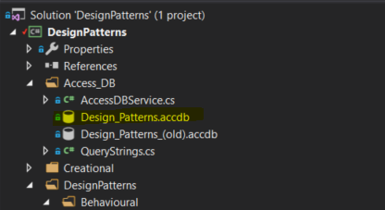
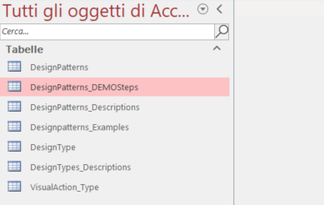
Console Project – Database description
The database is a simple Access file located in the project:
Main tables are the following:

Slide 3
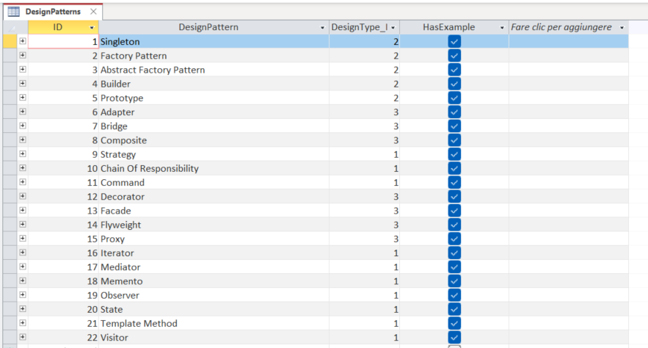
Console Project – Database description – Design Patterns
In this table the list of all design patterns showed in the main page is contained: for each of them:
The designType_ID specifies the DesignType (Behavioural, Structural or Creational)
The HasExample flag just tells if the DEMO button (and hence a demo) should be given:

Slide 4
Console Project – Database description – Descriptions
The DesignPatterns_descriptions tells the list of the description and how to insert them for each available design pattern. In the following slides the meaning of the different column are listed:

Slide 5
Console Project – Database description – Descriptions
The DesignPatterns_descriptions tells the list of the description and how to insert them for each available design pattern. In the following slides the meaning of the different column are listed:

Slide 6
Console Project – Database description – Descriptions
The DesignPatterns_descriptions tells the list of the description and how to insert them for each available design pattern. In the following slides the meaning of the different column are listed:

Slide 7
Console Project – Database description – Descriptions
The DesignPatterns_descriptions tells the list of the description and how to insert them for each available design pattern. In the following slides the meaning of the different column are listed:

Slide 8
Console Project – Database description – Descriptions
The DesignPatterns_descriptions tells the list of the description and how to insert them for each available design pattern. In the following slides the meaning of the different column are listed:

Slide 9
Console Project – Database description – Descriptions
The DesignPatterns_descriptions tells the list of the description and how to insert them for each available design pattern. In the following slides the meaning of the different column are listed:

Slide 10
Console Project – Database description – Descriptions
The DesignPatterns_descriptions tells the list of the description and how to insert them for each available design pattern. In the following slides the meaning of the different column are listed:

Slide 11
Console Project – Database description – Descriptions
The DesignPatterns_descriptions tells the list of the description and how to insert them for each available design pattern. In the following slides the meaning of the different column are listed:

